Slide 1


Automatic Solar Lighting System Atahan Bakanyildiz, Romi Gilat, Cedar Maxwell, Nick Miller

Slide 2
What is the Automatic Solar Lighting System?
Problem: Electricity can be unreliable within the Texas power grid, as demonstrated by the February 2021 snowstorm emergency, which resulted in the tragic loss of over 246 lives. With the increasing demand on the power grid, the importance of independent power sources becomes clear. This is where the automatic solar lighting system comes into play.
Notes:
transition: “So, what does this system look like?”

Slide 3
Solution
By integrating solar panels into homes, individuals can have peace of mind knowing they will have reliable power for up to a week during emergencies. This system will provide lighting, activated by motion, for the foyer and patio, and can be controlled remotely via an app for convenient access.
In the future, this system can be expanded to integrate security systems, HVAC systems, or water management systems, providing a comprehensive solution for home automation and energy independence.

Slide 4
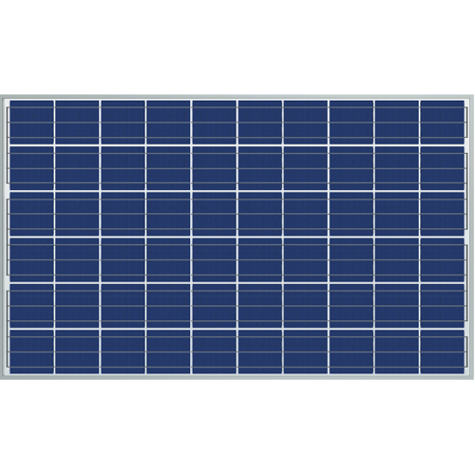



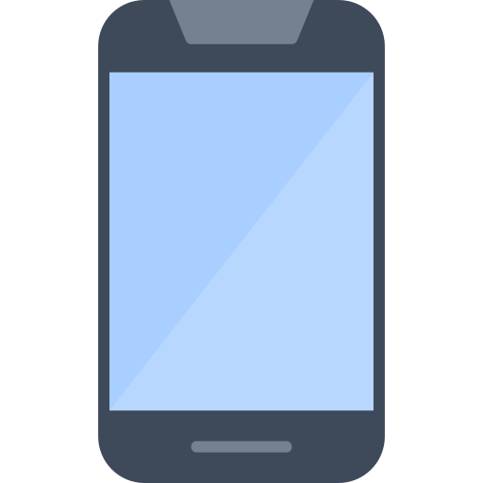
System Visual
PIR/Ambient Sensor
PIR Sensor
MCU
Cloud Database
App
Buck Converter and Inverter
Charge Controller and 12V Battery
Patio
Foyer

Slide 5
Project component breakdown
12V Lead-Acid Batteries
Solar Panels
Microcontroller unit
Interior & exterior sensors
Inverters
Buck converters
Light bulbs
App
Cloud Database

Slide 6
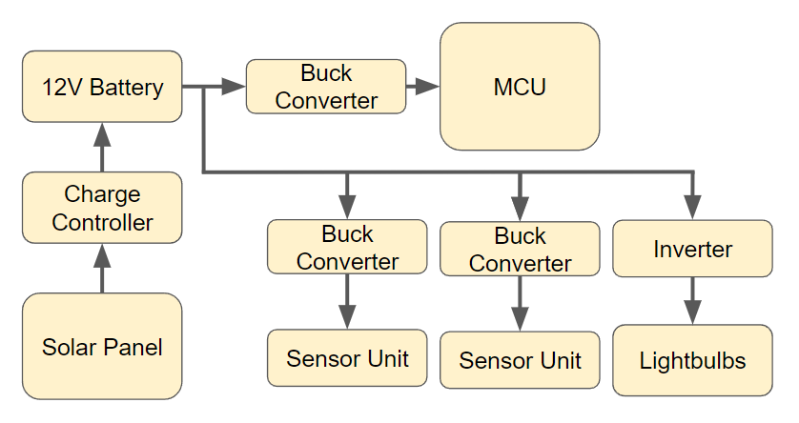
Electrical layout
Between battery and the MCU
Buck converter 12V => 5V
Between battery and bulbs
Inverter
12V DC => 120V AC
Charge controller
Solar Panel 17-20V => PWM charging
Between battery and sensors
Buck converter
12V => 3.3V
Notes:
nick

Slide 7
System Interface
Microcontroller Unit
Charge Controller
Inside Sensor
Outside Sensor
Solar Panel
Controllers and Sensors
Cloud Database
Control
12V Battery
Power Generation
App
Buck Converter
Converter/Inverter
Power
Data
Load & Inversion
Nick: Load & Inversion Atahan: Power Generation
Romi: MCU & Sensor Cedar: App & Database

Slide 8
Task Partition
Nick: Designing and manufacturing Buck Converters and Inverter for optimized voltage supply to MCU, sensors, and lighting.
Romi: Developing the MCU and sensor units for data collection, lighting control, and app connection.
Atahan: Designing a solar power charge controller PCB for efficient battery charging.
Cedar: Creating an Android app and cloud database for system control and data interface.

Slide 9
Subsystem progress in the past 1.5 months
Nick: During the last month and a half, I have conducted extensive research and simulations in designing the Buck Converters and ensuring proper results. Additionally I have begun the PCB introduction assignment and ordering parts for the Buck Converters.
Romi: Over the past month and a half, I have researched components that best meet the requirements, ordered components, designed a preliminary schematic, and begun the initial tasks.
Atahan: Up until now, I have researched the components used in creating a solar power charge controller to find the right parts that best meet our system’s requirements, created circuit-level schematics for the controller, and started on initial tasks.
Cedar: I have created a basic Android mobile app and have begun working on integrating this app with a cloud Firebase database.

Slide 10
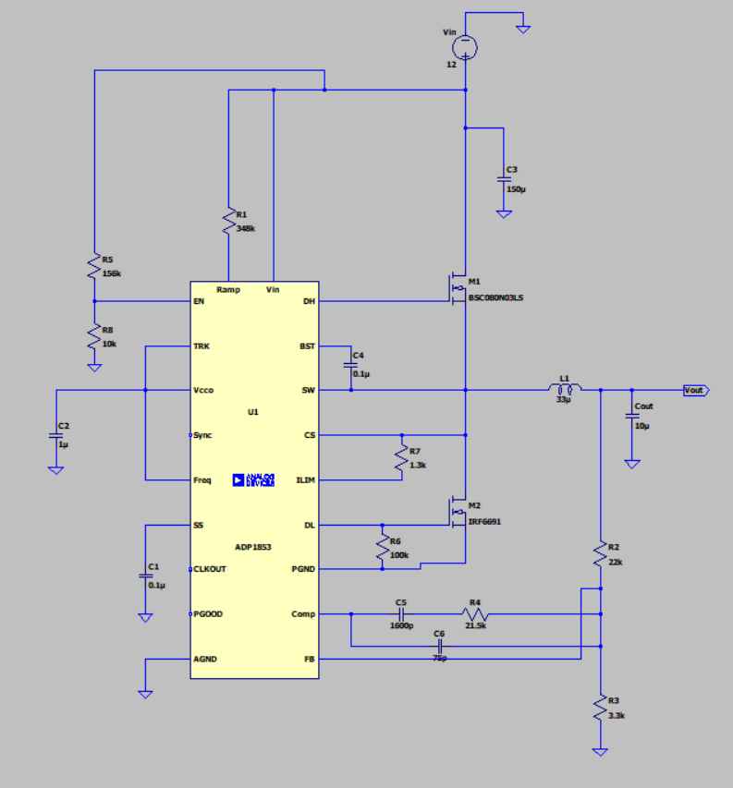
Inverter & Buck converter
Buck Converters
A total of two switching Buck converters used in the system.
Connecting battery to MCU.
Connecting battery to sensor unit.
Each converter is designed to step down a 12V input.
5V for MCU.
3.3V for sensor unit.
DC to AC Inverter
3.3V DC to 120V AC.
Provide power to foyer and patio lights.
60 watt LED light bulbs using 8.3 watts.

Slide 11
Inverter & buck converter - What’s next?
Goals for the next two weeks:
Breadboard the Buck Converters.
Ensure that Buck Converter from battery to MCU outputs a steady 5V.
Ensure that Buck Converter from battery to Sensor System outputs a steady 3.3V.
Test outlier cases (Decay values for battery, higher/lower voltage inputs than nominal value of battery)
Design/order PCB boards for Buck Converters.
Reach Goal:
Design and simulate the Inverter.
Run simulations using LTspice.
Order Inverter components.
Design PCB board for Inverter.

Slide 12
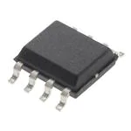
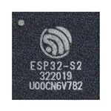
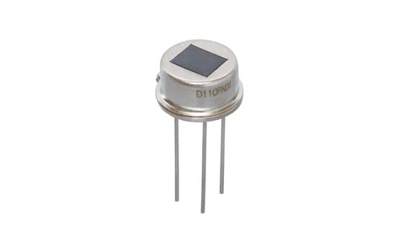
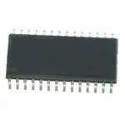
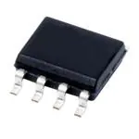
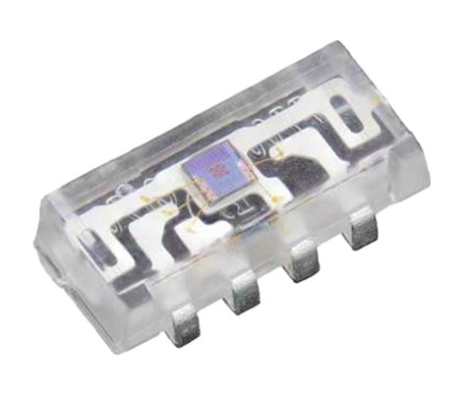
Microcontroller & Sensor system
Microcontroller Unit
This subsystem will connect the lighting system, web app, and collect data coming from the battery system
Make use the ESP32’s capabilities
Bluetooth and Wifi connection to the cloud based application
Will deliver data about the battery, light system
UART
IEEE 802.111
App System
Sensor Unit
Ambient light sensor with 580-620 wavelength
Passive infrared sensor with 23 feet of range
One for exterior
Two for interior
These sensors will communicate with the microcontroller using TTL to trigger the lighting system
85°
radius
Sensor Data to
PIC
PIC to RS485
Orange λ ≈ 600 nm
Notes:
romi

Slide 13
MCU & Sensors - What’s next?
Goals for the next two weeks:
Complete Op Amp & microcontroller assignments
Breadboard the MCU
Breadboard interior and exterior sensor systems
Receive proper TTL signal between MCU & sensors
Receive signal from PIR sensor to microcontroller
Reach Goal:
Began PCB design for MCU
Began PCB design for interior & exterior sensors
Notes:
romi

Slide 14
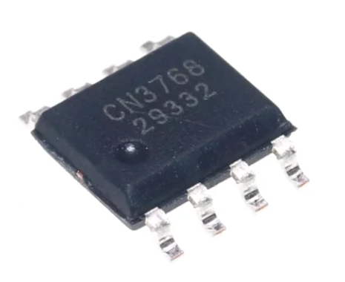
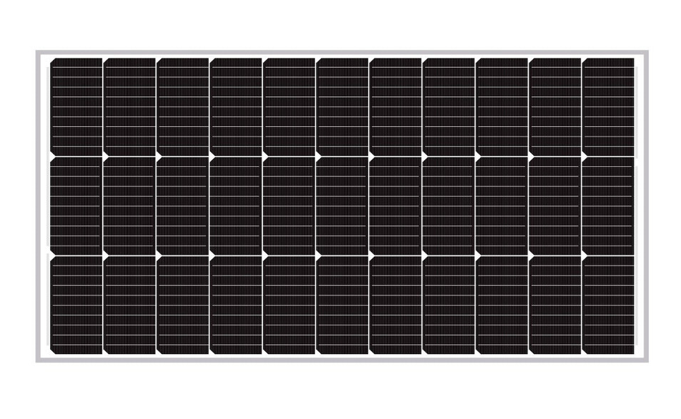
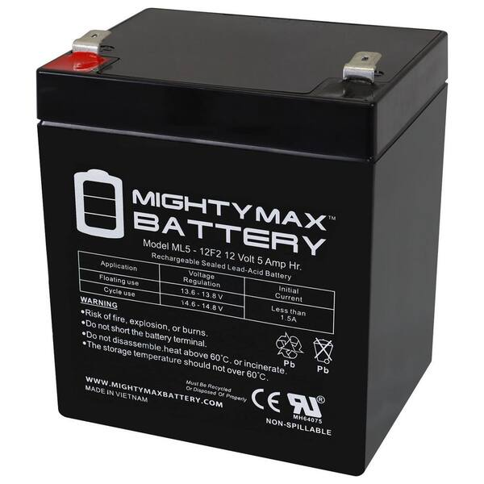
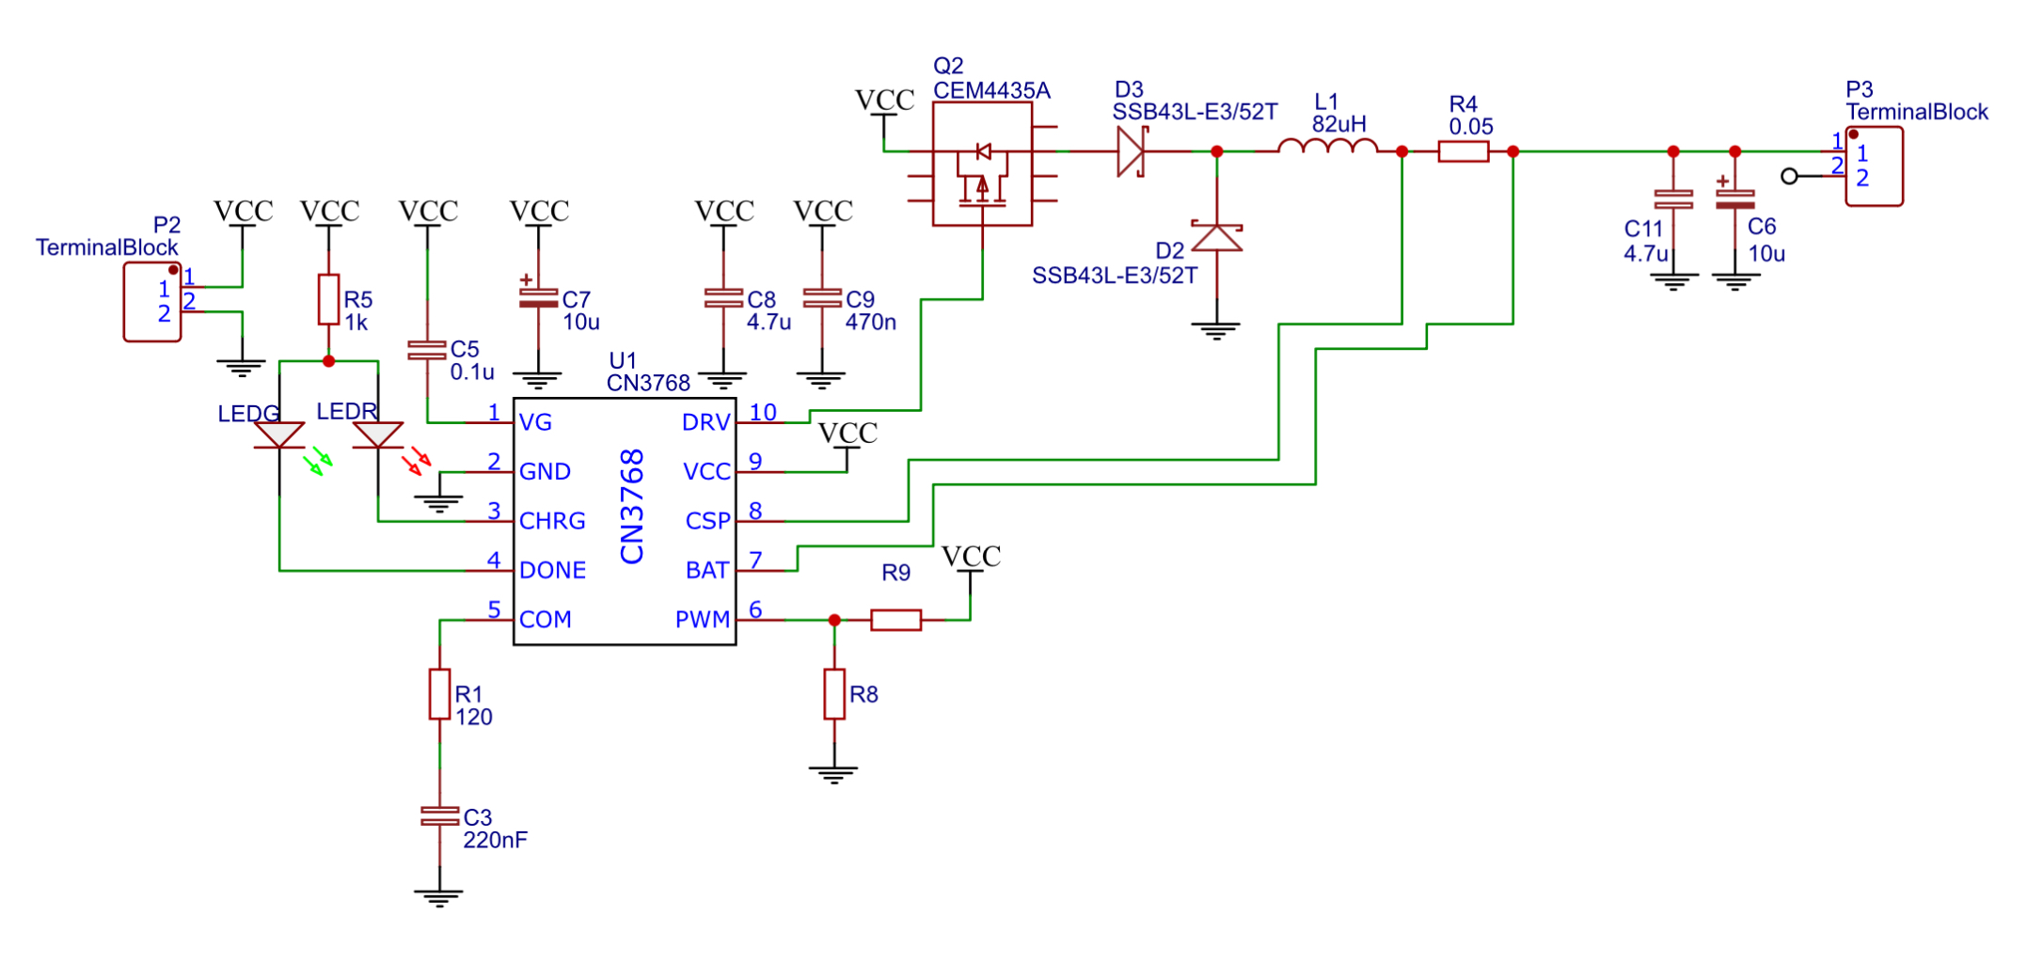
Power Generation
NPA100-12H Solar Panel
Generate power for whole system
100 W
6.26 A
14-20 V
Charge Controller
Enable efficient charging from solar power to battery
Track Solar Efficiency and Battery charge status
CN3768
Overcharge, overdischarge, overcurrent protection
ML5-12F2 12V Battery
Provide power to all other components in system
12 V
5 A
Lead-Acid
Compact Design

Slide 15
Power generation - what’s next?
Goals for the next two weeks:
Introductory assignments are completed
All components are ordered
Design PCB for charge controller with circuit protection elements
Reach Goal:
Begin testing components with breadboarding
Test solar panel and battery with off-the-shelf charge controller

Slide 16
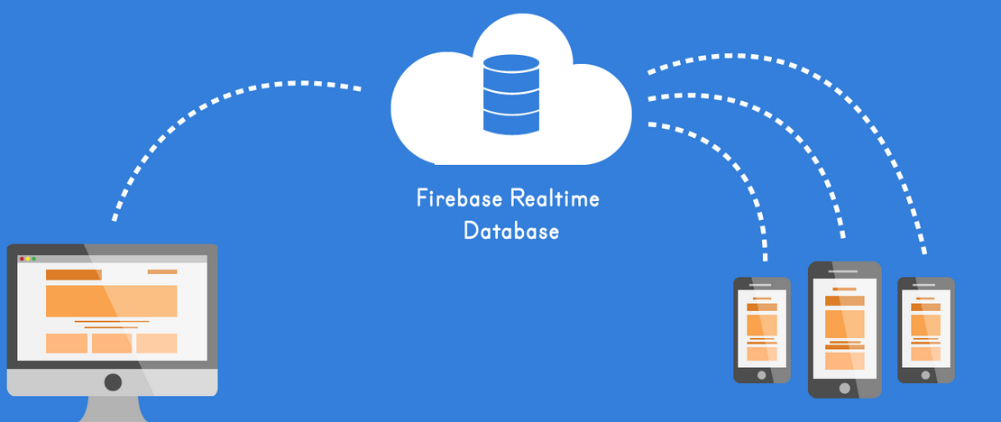
App & Data integration
App
Shows data such as battery level and sensor status from database relayed from microcontroller
Allows user to manually control the System
Database
Firebase database enables online access to all the microcontroller’s data
This allows the User to use the App to manually control the System even while the User is away from home

Slide 17
App & Database - what’s next?
Goals for next two weeks
App
Introductory assignments are completed
Basic UI complete
Database
Template database established
Reach goal
App
Polished UI complete
Database
True database developed and in connection with the app

Slide 18
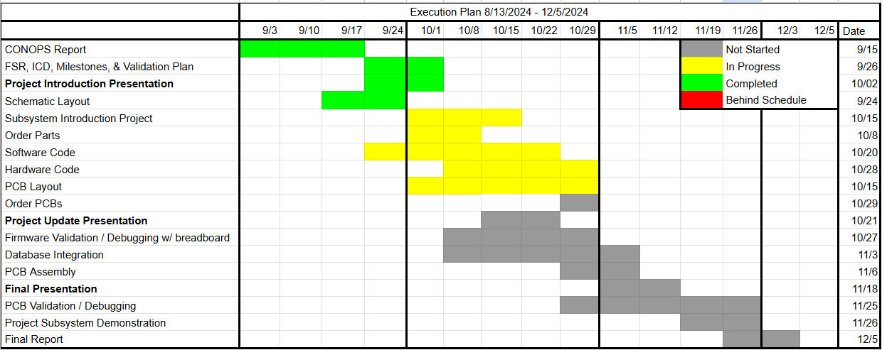
Subsystem progress:

Slide 19
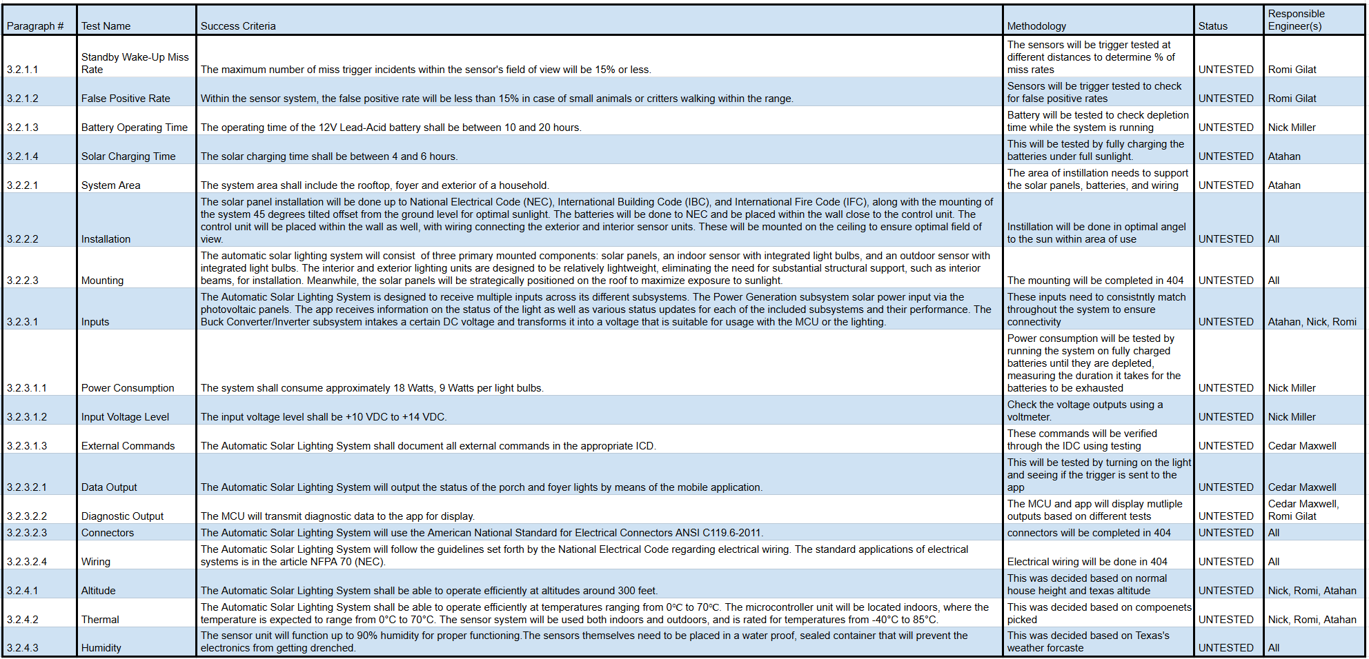
Verification Schedule

